Slide 1
Simple Salesforce Bank
SPEAKER: JUSTIN PASSANISI

Slide 2

INTRODUCTION
SDLC & Trello
ERD
Bank Security
Security Super badge
Extra Features
Demo
Results

Slide 3
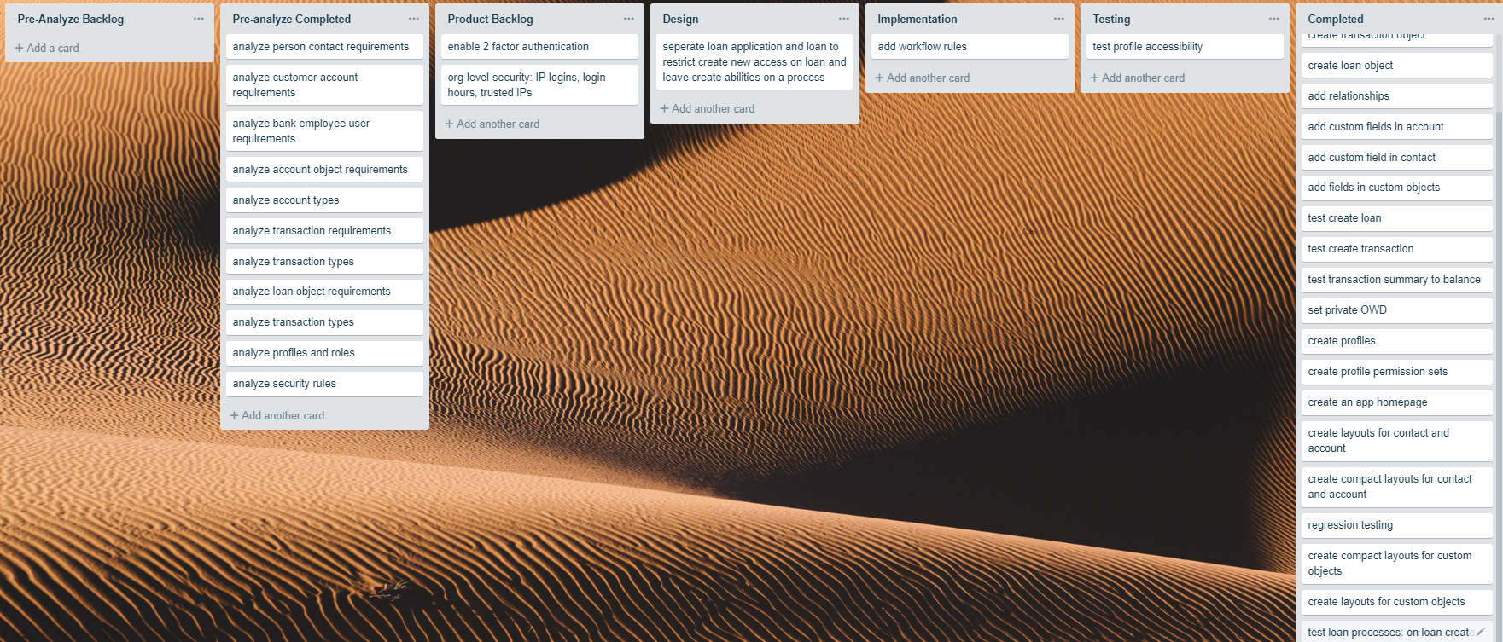
Workflow: Trello

Slide 4
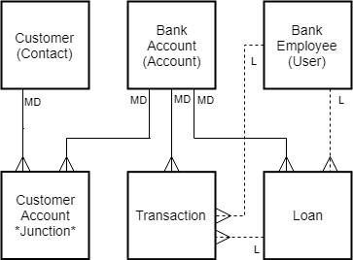
ERD

Slide 5
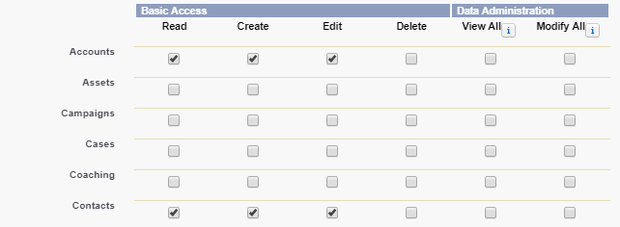
Security
FOUR LEVELS:
  ORG LEVEL SECURITY
  Future Considerations
  OBJECT LEVEL SECURITY
    Profiles: Bank Employee Profile
        Permission for Create, Update, and Delete List Views Permissions
        OBJECT PERMISSIONS: CUSTOMER ACCOUNTS – Read, Write, Edit, Delete
        ACCOUNT – Read, Write, Edit LOANS – Read, Create, Edit
        CONTACTS – Read, Write, Edit Transactions – Read, Create, Edit

Slide 6
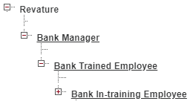
Security
  RECORD LEVEL SECURITY
    OWD: Private Level Security (Account, Contact, Custom Objects)
    Role Hierarchies
    Sharing Rules
    Manual User Record Sharing Enabled

Slide 7
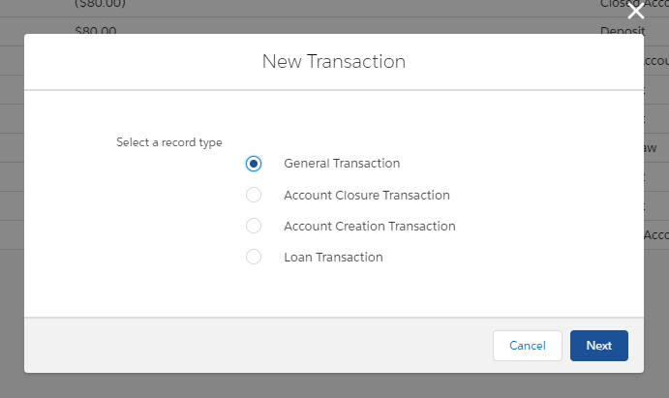
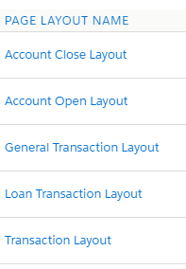
Security
  FIELD LEVEL SECURITY
    STANDARD UNUSED FIELDS in STANDARD OBJECTS
    & Field Level Security
    Page Layouts
    Record Types

Slide 8
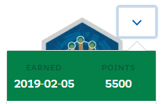
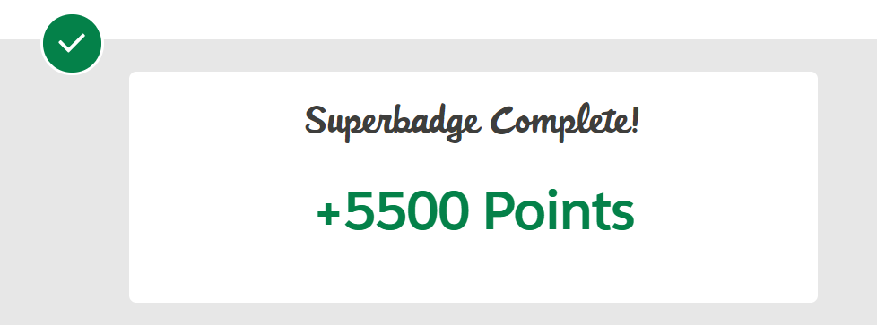
SUPERBADGE

Slide 9
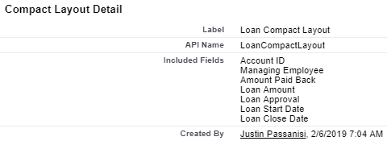
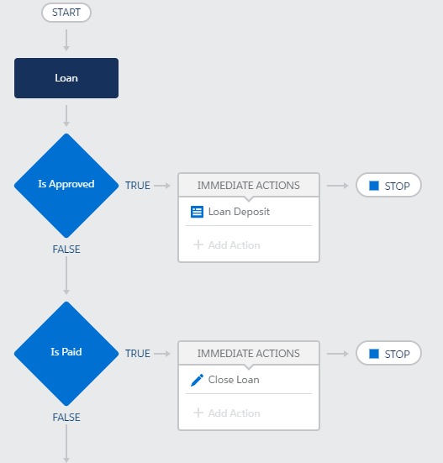
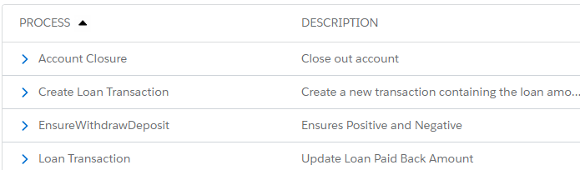
Extra Features: Process Builder, Layouts

Slide 10
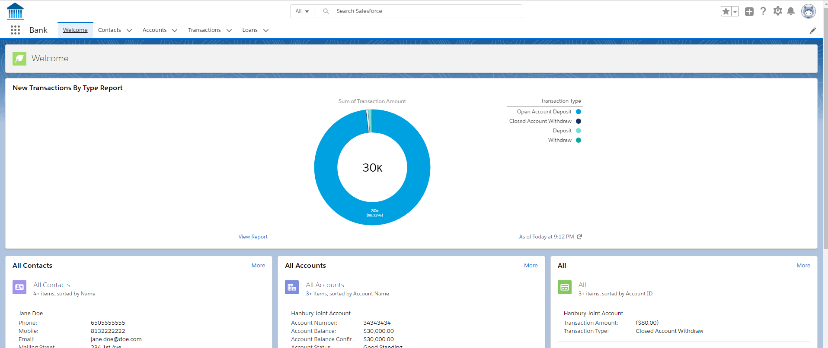
DEMO

Slide 11
Results
SDLC
Data Modelling
Security
Deployment
QUESTIONS?

